Slide 1




Analytics & Solutions
for NCHS
Faster Care, Better Care, Healthier Society.
Seminar Class 3, Team 1
Team Members:
Javier Tan
David Tey Bo Yuan (U2121810J)
Eric Wu Jiaqing
Syed Saad Muntasirul Islam
Shermaine Ng Jinglin

Slide 2



Content
01
Problem
05
Proposed Solution
02
Business Opportunity
06
Methodology
03
Objective
07
Evaluation
04
Current Solution
08
08
Conclusion

Slide 3
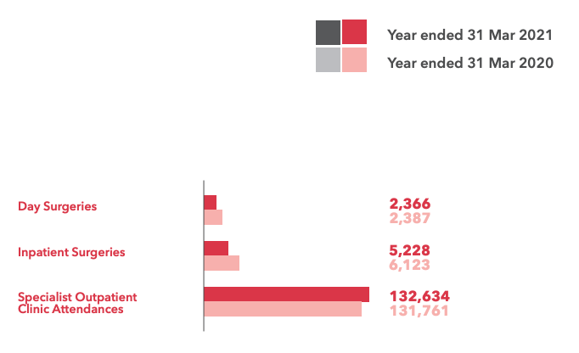
Problem
As the leading centre for cardiovascular health in region, the NHCS treats thousands of patients a year.
Outpatients made up 94.6% of all the patients treated by the NHCS as of March 2021.
A significant portion of their resources are used up by these outpatient services.
Numbers are only expected to rise as heart disease becomes more prevalent. (MOH, 2021)
NHCS Annual report 2020-2021
Syed Saad

Slide 4
OVER-REFERRED
OVER WORKED
OVERLOADED
Syed Saad

Slide 5
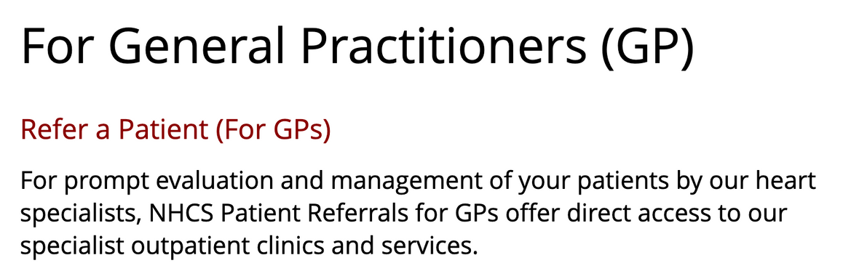
Over-referred
Primary way to get an appointment at NHCS is through referrals by General Practitioners (GP).
GPs refer patients to specialists for further evaluation on serious conditions.
This has led to serious over-referral rates to specialist centres, including the NHCS
research found that 7 out of 10 referred patients did not need to see a specialist (Lai, 2021)
Taken from NHCS website
Syed Saad

Slide 6

Overworked
Singapore's healthcare workers are severely overworked (CNA, 2022) and are at risk of burnout.
More staff are quitting due to the increasing fatigue (Straits Times, 2021).
Singapore only has 2.3 physicians per 1000 people as of 2016 (World Bank).
NHCS is no exception.
Juanmonino/iStockphoto
Syed Saad

Slide 7

Overloaded
These issues have caused the NHCS to be overloaded.
Longer waiting times for patients from 4-6 weeks (Tan, 2020).
Doctors and staff would be more preoccupied with other duties.
Fewer resources for each patient.
Leads to an overall decrease in quality of care.
Getty Images/iStockphoto
Syed Saad

Slide 8
Business Opportunity and Hypothesis
Machine learning has the ability to analyse large amounts of data to observe trends, discover new insights, and classify data
The problems faced by NHCS has the potential to be solved by machine learning
Solving these problems will lead to cost-savings, higher morale, better care
NHCS' reputation as the leader in cardiovascular care would be solidified in the region and even worldwide
Syed Saad

Slide 9
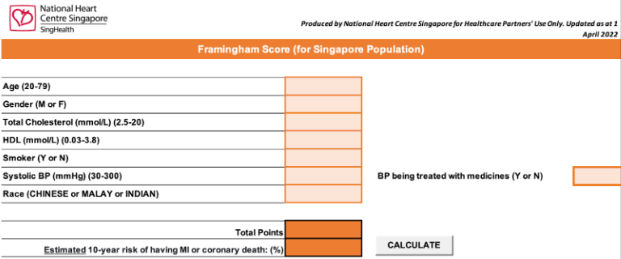
Current Solution
Framingham Risk Score
Simple excel calculator to allow GPs to calculate a patient's estimated 10-year risk of developing heart disease.
GPs will refer patients to NHCS based on their Framingham Risk Score.
Shermaine Ng

Slide 10
Limitations I
Outdated
Abitrary
Inaccuracy
Calculations are based on data obtained in Framingham Heart Study from decades ago. Last updated in 2008.
Difficulty in objectively evaluation the Framingham Risk Score accuracy due to several biases over the 10 years timespan.
Research on Framingham Risk Score reveals a lack of predictive accuracy in risk assessment tools and techniques (Blaha, 2015).
Shermaine Ng

Slide 11

Limitations II
Framingham Risk Score detect patients at risk of developing heart disease over the span of 10 years, and not the immediate estimated risk.
Unnecessary referrals to NHCS which puts a strain on the healthcare workers and results in inefficient allocation of resources.
Overestimate the risk of a patient developing heart disease. No information about whether immediate specialist attention is required.
Shermaine Ng

Slide 12





Our Solution
Predicting Immediate Risk
Priority Referral
One Connected Interface
Our solution aims to tackle the inefficiency of predicting 10-year risk by enabling GPs to more accurately detect a person’s immediate risk level of developing heart disease.
Patients that are predicted to have more serious stages of heart disease would be given higher priority. The most urgent, high risk cases would be treated first, followed by those of a lower risk after
Our solution will be made available on the web and GPs can just access the website from their work computer. Patient data will be stored in a centralised database for tracking of patients and to receive updates on the patients’ status.
READ MORE
Javier Tan

Slide 13

Predicting Immediate Risk
By looking at their immediate risk, GPs would be able to make more informed and accurate decisions to refer the patients to heart specialists.
This would also allow them to provide better preventive care to the other patients who do not need urgent help from specialists.
Lessen the burden on NHCS staffs and reduce wastage of resources
Reduce the long appointment times to see heart specialists and allow those who urgently need the care to receive it as promptly as possible
Javier Tan

Slide 14

Priority Referral
Knowing a patient’s immediate risk level would also allow GPs to indicate priority levels to their referrals
Patients that are predicted to have more serious stages of heart disease would be given higher priority
Jurgen Ziewe/Getty Images
Javier Tan

Slide 15

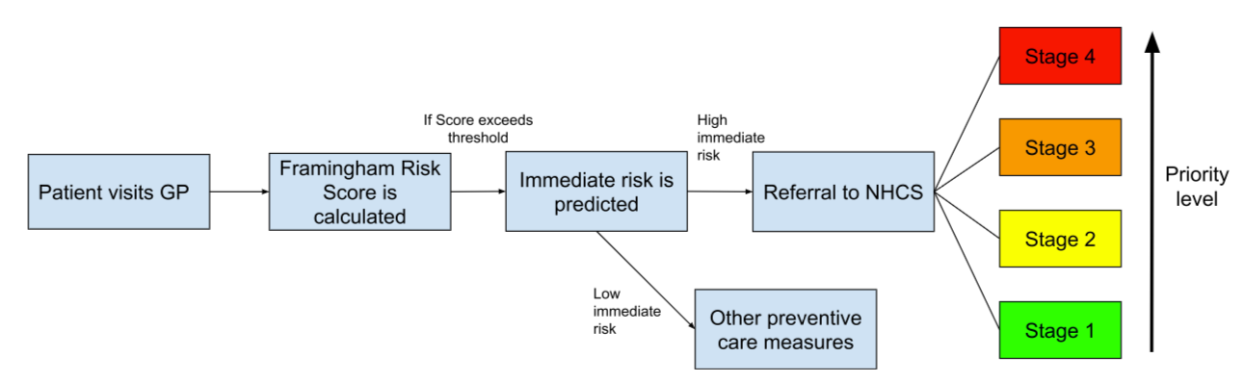
Recommended
Referral Process
Our recommended approach on how to best implement our analytics solutions to achieve more accurate referrals as well as prioritise patients that are in need of the most urgent care.
Javier Tan

Slide 16
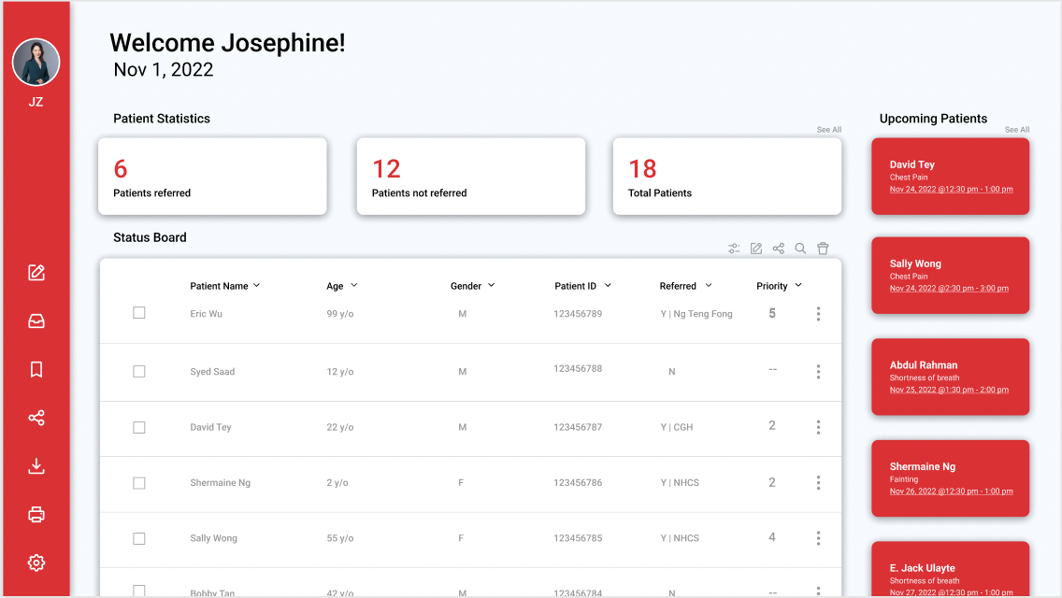
Prototype
Our solution will be made available on the web and GPs can just access the website from their work compute
GPs can just log in and create a patient profile along with the patient data obtained from his preliminary tests and receive a binary decision of whether to refer the patient or not
Javier Tan

Slide 18
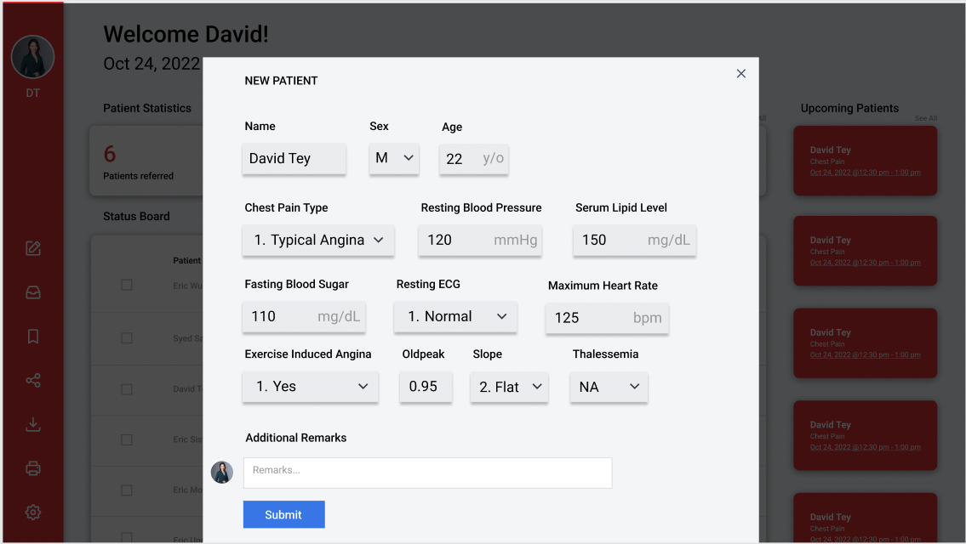
Prototype
GPs can just log in and create a patient profile along with the patient data obtained from his preliminary tests and receive a binary decision of whether to refer the patient or not
Javier Tan

Slide 19

Methodology: Data Set
List of Independent Variables:
Age
Sex
Chest Pain type
Resting blood pressure
Fasting blood sugar level
Cholesterol level
Thalassemia
ST depression
Maximum Heart rate
Peak slope of ST segment
Exercise induced angina
Resting ECG Results
No. of major vessels colored by fluoroscopy
Machine learning depository
Dependent Variable:
Heart disease stage
0: disease free
1-4: corresponding stages of heart disease
David Tey

Slide 20

Methodology: Clustering
Overview
Identifies groups within our dataset by looking at the similarities and differences between patients
Improve accuracy of prediction
Methods Chosen
Clustering Illustration
K-means clustering:
- optimal value: 10 clusters
Hierarchical clustering:
- optimal value: 8 clusters
David Tey

Slide 21

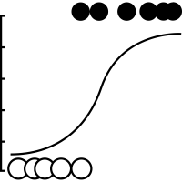


Methodology: Logistic Regression & CART
Default Dataset
Logistic Regression
CART
K-means Clustering
Hierarchical Clustering
Binary Classification
David Tey

Slide 22
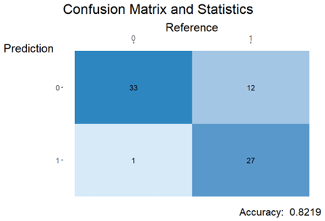
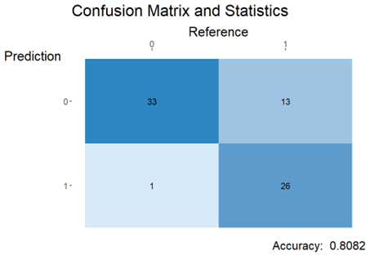
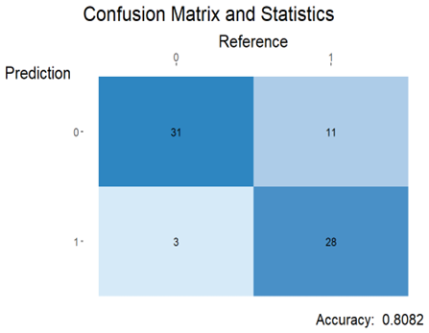
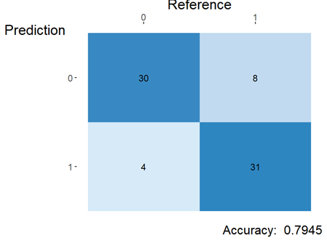
Methodology: Logistic Regression Accuracy
Default model: 82.19%
K-means clusters: 80.82%
Hierarchical clusters: 80.82%
Binary Variables: 79.45%
David Tey

Slide 23
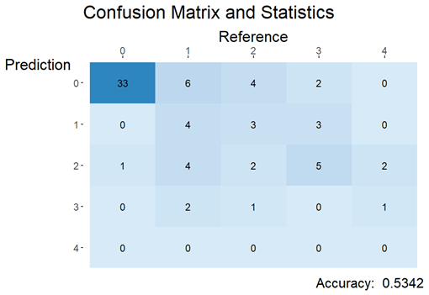
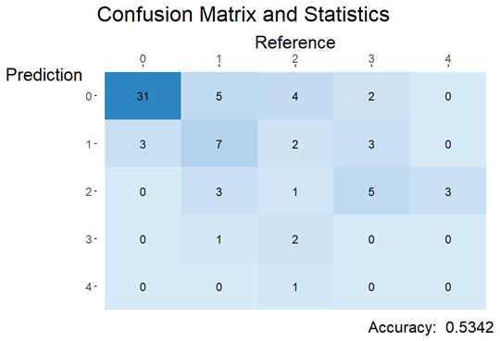

Methodology: Logistic Regression Accuracy
Default model
K-means clusters
Hierarchical clusters
Accuracy: 53.42%
Accuracy: 53.42%
Accuracy: 57.53%
David Tey

Slide 24
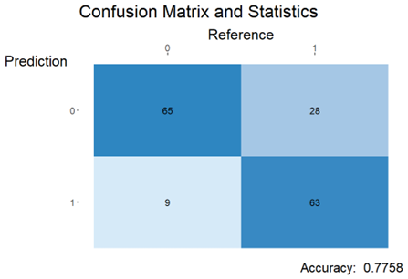
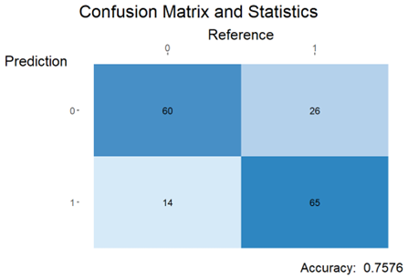
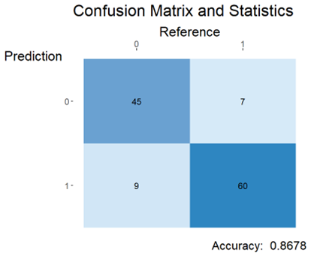

Methodology: CART Accuracy
Default model: 77.58%
K-means clusters: 75.76%
Hierarchical clusters: 74.55%
Binary Variables: 86.78%
David Tey

Slide 25
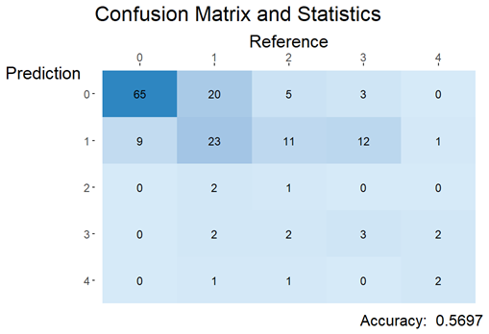


Methodology: CART Accuracy
Default model
K-means clusters
Hierarchical clusters
Accuracy: 56.97%
Accuracy: 52.73%
Accuracy: 53.94%
David Tey

Slide 26


Evaluation: Binary Predictions
CART Model : binary dependent variable
Model Accuracy | False Negative Rate | False Positive Rate
CART: 86.7% | 10.4% | 16.7%
Logistic Regression: 82.2% | 30.8% | 2.86%
Default Logistic Regression: original dataset
CART has higher overall accuracy and lower false negative rate
Logistic Regression has lower overall accuracy and lower false positive rate
Choose CART >> Logistic Regression since consequences of false negative are more severe
Eric Wu

Slide 27


Evaluation: Multi-Class Predictions
Default CART model: original dataset
Logistic Regression Model: hierarchical clusters
Accuracy: 56.97%
Accuracy: 57.53%
Eric Wu

Slide 28
Evaluation: Business Impact
84, 866
Unnecessary Referrals Eliminated
Eric Wu

Slide 29
Evaluation: Business Impact
$3,224,908
Dollars Saved
Eric Wu

Slide 30
Conclusion
New Referral Process:
Outcomes :
New systematic way of evaluating priority of patient urgency
Improved efficiency and cost savings by eliminating unnecessary referrals
Pave the ways for future adaptation of analytics methods in public healthcare
Eric Wu

Slide 31


Thank
You

Slide 32
References
Tan, C (2021, November 1). More healthcare workers in Singapore are resigning due to fatigue. The Straits TImes. https://www.straitstimes.com/singapore/politics/more-healthcare-workers-in-spore-resigning-amid-growing-fatigue-as-covid-19-drags
Tan, J. (2020, September 18). Seeing a cardiologist in Singapore: The Complete Guide (2021). Human. Retrieved October 24, 2022, from https://www.human.com.sg/the-complete-guide-to-seeing-a-cardiologist-in-singapore
Lai, L. (2021, November). News. HealthXchange. Retrieved October 24, 2022, from https://www.healthxchange.sg/news/new-initiative-nhcs-shp-saves-heart-patients-time-money
Singhealth DukeNUS Annual Report 20-21. https://www.singhealth.com.sg/about-singhealth/newsroom/Documents/[Web%20Version]%20SingHealth%20DukeNUS%20Annual%20Report%2020-21.pdf
Lim, B (2022) https://www.channelnewsasia.com/commentary/frontline-workers-burnout-covid-19-quit-leave-hospital-doctor-nurse-health-2553806
https://data.worldbank.org/indicator/SH.MED.PHYS.ZS?locations=SG-US-GB-NO&most_recent_year_desc=true

